Slide 1

Geometry
Unit 10, Lesson H1 Constructing Tangent Lines Volume 2, pg. 169

Slide 2


Benchmark
MA.912.GR.5.5
Given a point outside a circle, construct a line tangent to the circle that passes through the given point.
volume 2, pg. 169

Slide 3
Integrated Mathematical Thinking and Reasoning Standards
MA.K12.MTR.1.1 Actively participate in effortful learning both individually and collectively.
MA.K12.MTR.2.1 Demonstrate understanding by representing problems in multiple ways.
MA.K12.MTR.4.1 Engage in discussions that reflect on the mathematical thinking of self and others.
MA.K12.MTR.5.1 Use patterns and structure to help understand and connect mathematical concepts.
volume 2, pg. 169

Slide 4

Learning Target
I can construct a line tangent to a circle that passes through a given point outside the circle.
volume 2, pg. 169

Slide 5

Warm-Up
volume 2, pg. 170

Slide 6
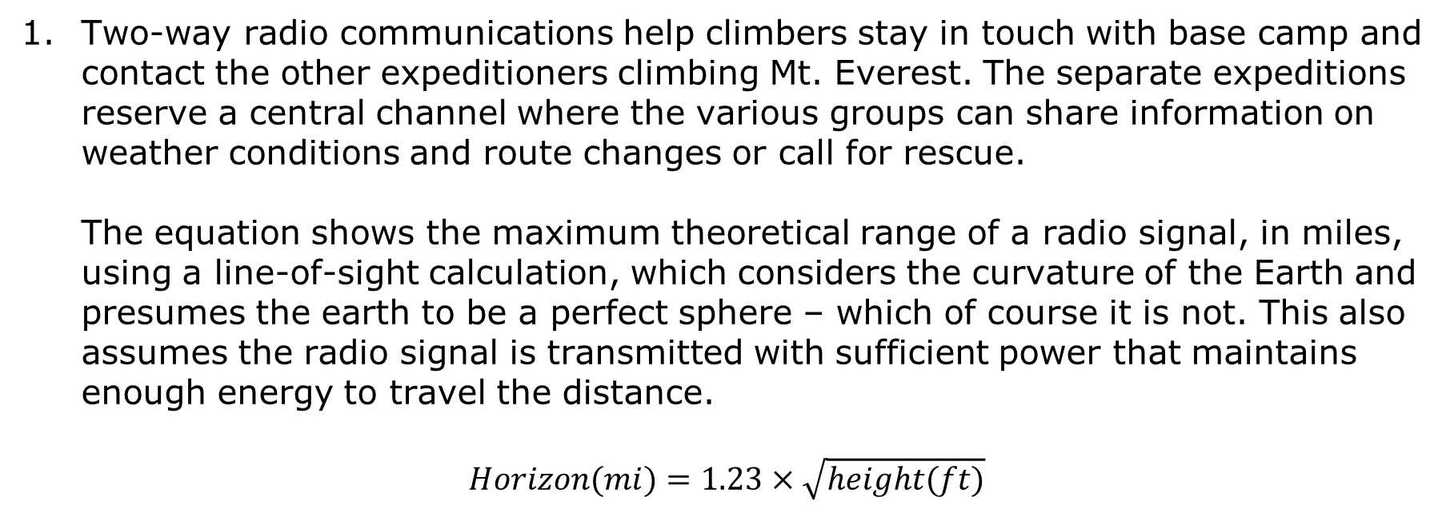
10.H1.1 Warm-Up: Radio Signals
Two-way radio communications help climbers stay in touch with base camp and contact the other expeditioners climbing Mt. Everest. The separate expeditions reserve a central channel where the various groups can share information on weather conditions and route changes or call for rescue.
The equation shows the maximum theoretical range of a radio signal, in miles, using a line-of-sight calculation, which considers the curvature of the Earth and presumes the earth to be a perfect sphere – which of course it is not. This also assumes the radio signal is transmitted with sufficient power that maintains enough energy to travel the distance.
$$Horizon(mi)=1.23×\sqrt{height(ft)}$$
volume 2, pg. 170

Slide 7
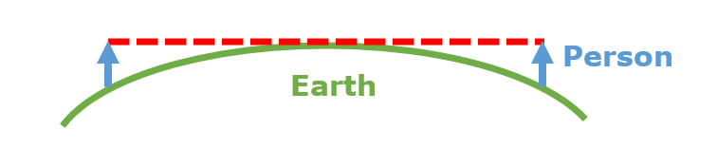
Use the formula to find the distance the radio signal would go based on your height.
Explain the relationship of the radio signal range (red line) and Earth.
volume 2, pg. 170

Slide 8

Collaboration
volume 2, pg. 170

Slide 9

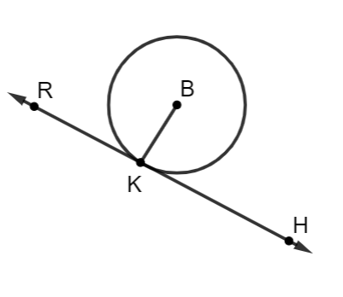

10.H1.2 Collaboration: Tangent Lines of Circles
Circle $B$ is shown, with point $K$ on the circle and $\overset{⃡}{RK}$ tangent to circle $B$.
Write two facts about circle $B$ and tangent line $\overset{⃡}{RK}.$
Share your facts with your partner and write down one additional fact.
1.
2.
3.
volume 2, pg. 170

Slide 10
Complete the statement.
A line tangent to a circle touches a
circle at point(s), and the line
is to the radius of the circle.
one
two
three
parallel
perpendicular
volume 2, pg. 170

Slide 11
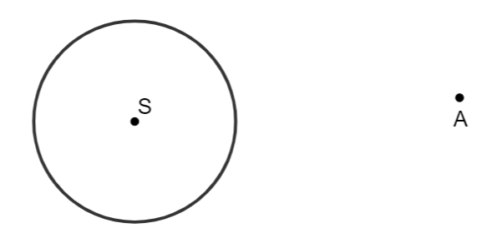
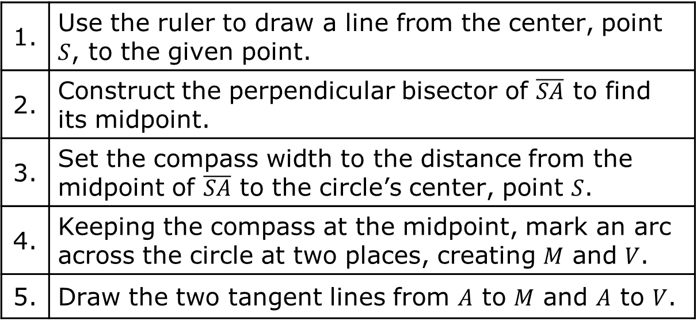
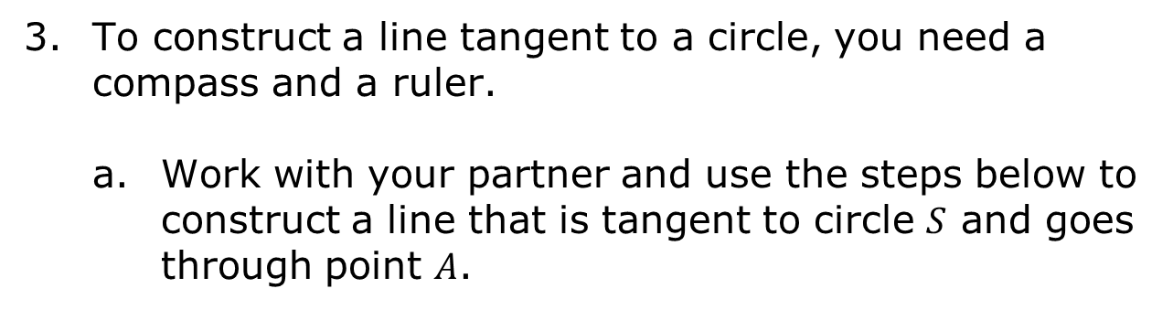
To construct a line tangent to a circle, you need a compass and a ruler.
Work with your partner and use the steps below to construct a line that is tangent to circle $S$ and goes through point $A$.
1. | Use the ruler to draw a line from the center, point $S$, to the given point.
2. | Construct the perpendicular bisector of $\overline{SA}$ to find its midpoint.
3. | Set the compass width to the distance from the midpoint of $\overline{SA}$ to the circle’s center, point $S$.
4. | Keeping the compass at the midpoint, mark an arc across the circle at two places, creating $M$ and $V$.
5. | Draw the two tangent lines from $A$ to $M$ and $A$ to $V$.
volume 2, pg. 171

Slide 12
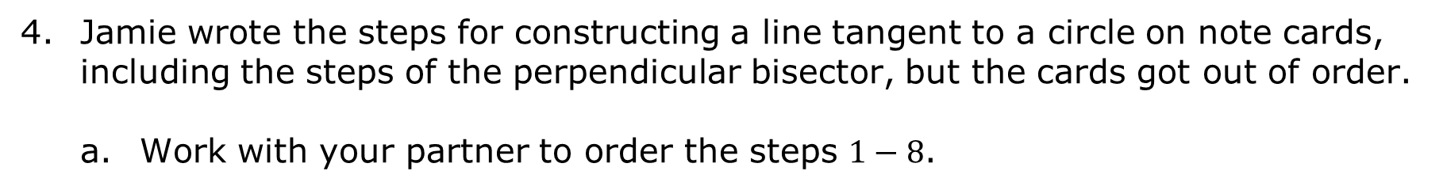
Jamie wrote the steps for constructing a line tangent to a circle on note cards, including the steps of the perpendicular bisector, but the cards got out of order.
Work with your partner to order the steps $1−8$.
 | Place the compass on the midpoint of the line segment and adjust its lengths to reach the center.
 | Place the compass at one end of the line segment and adjust the compass to slightly longer than half the line segment.
 | Place the ruler where the arcs are above and below the line cross, and draw the perpendicular line.
 | Keeping the same width and compass point at the midpoint, draw a circle.
volume 2, pg. 171

Slide 13
 | Draw arcs above and below the line.
 | Where the new circle crosses the original circle, create a point and draw the tangent line.
 | Draw a line connecting the center of the circle and the point outside the circle.
 | Keeping the same compass width, draw arcs above and below the line from the other end of the line segment.
Explain how Jamie’s method is different.
Explain why Jamie’s method works.
volume 2, pg. 171

Slide 14

Your Turn
volume 2, pg. 172

Slide 15
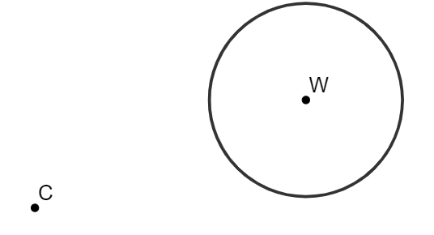
10.H1.3 Your Turn!
Given circle $W$ and point $C$ outside the circle, construct a line tangent to circle $W$ going through point using Jamie’s method.
volume 2, pg. 172

Slide 16
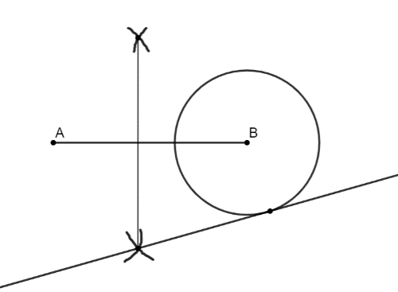
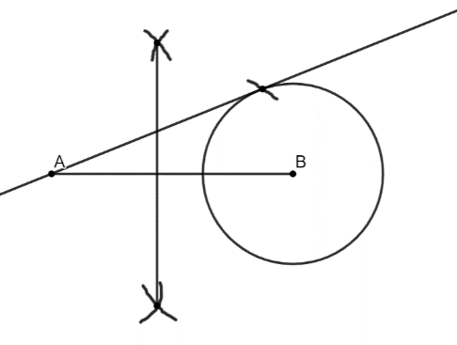

Naomi and Xavier were practicing constructing a line tangent to circle $B$ going through point $A$, but their results did not match.
Who correctly drew a line tangent to circle $B$ going through point $A$?
Explain the mistake the other student made.
Naomi’s Construction | Xavier’s Construction
volume 2, pg. 172

Slide 17

Wrap-Up
volume 2, pg. 173

Slide 18
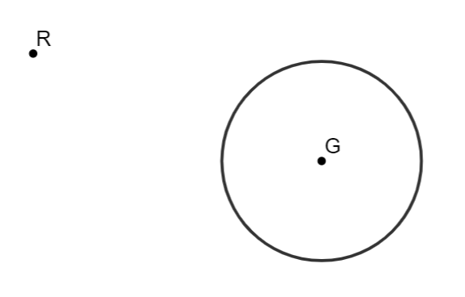
10.H1.4 Wrap-Up: Ticket Out the Door
Given circle $G$ and point $R$ outside the circle, construct a line tangent to circle $G$ going through point $R$.
volume 2, pg. 173

